Slide 1
Targeted Approach to Attain Happiness
​Agastya Kommanamanchi​
Gowtham Kommineni​
Abhishek Gorla
Elmedina Loga​
Jitender Tewari

Slide 2
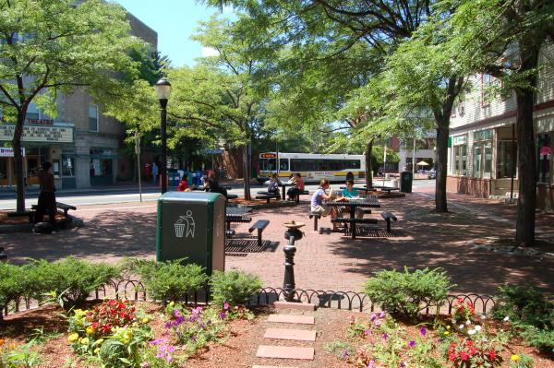
Introduction to Somerville Happiness Survey
Small city located near Boston
“Best Run City” by Boston Globe
First city to include questions that focus on happiness and wellbeing measurement
Combined dataset survey includes anonymous responses from the years of 2011,2013, & 2015
Somerville, Massachusetts

Slide 3
About the Dataset
Administered by SomerStat
Contains 6545 rows and 43 columns
Target areas like city Aesthetics, Safety, Availability of Public Services, Affordability of housing etc.
Responses are given on a scale to 1 to 10 for most of the questions and 1 to 5 for a few

Slide 4
Problem Statement
To bring happiness to the lives of less happy people
Identify the major quantitative and qualitative predictors of happiness​
Identify people that are unhappy and target them with specific determinants to bring about happiness

Slide 5
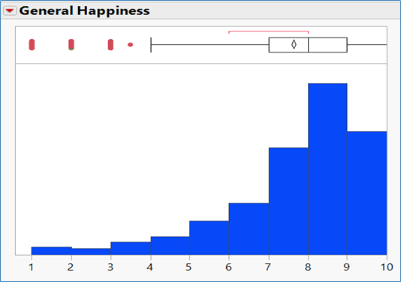
How happy are Somerville Residents
Mean – 7.65
77% rated 7 or more
10% gave a full 10

Slide 6
Where do we stand ?
What went well ?
General Happiness
Satisfaction at Somerville
Availability of Affordable Housing
What needs improvement ?
Resident’s Trust in Police.
Quality of Public Schools

Slide 7
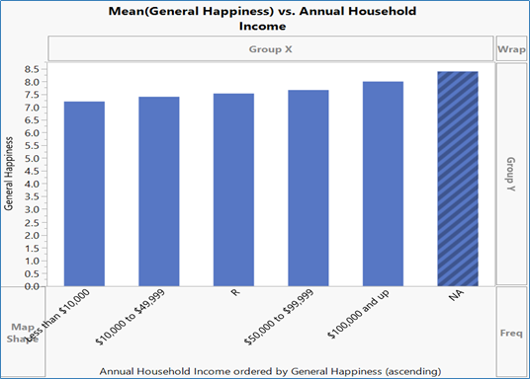
Income vs Happiness
Scale of 1 to 10
25% lie in highest income band
5 % in lowest income band
Is there a pattern ?

Slide 8
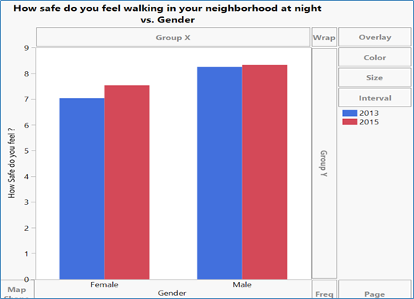
Safety at Somerville
Do males and females think alike when it come to Safety at Somerville ?

Slide 9
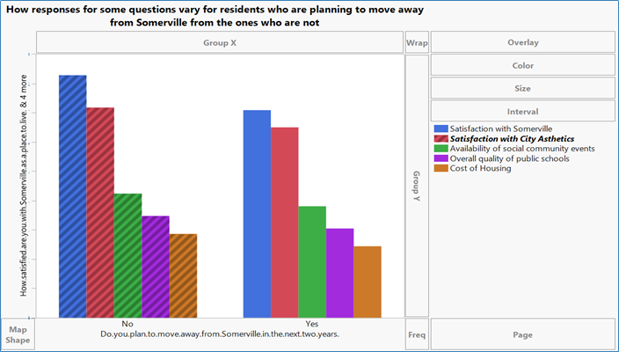
Can satisfaction at Somerville really affect people’s decision of staying here ?

Slide 10

Data Wrangling
Issues with the Data and Challenges faced during handling those issues
Notes:
Even Before starting the general exploration of data for patterns, trends and technical exploration for any outliers and missing values There were a lot of issues we found with the data
Now lets see

Slide 11
Inconsistency in the questions
Differently worded questions.
E.g. The overall quality of public schools in your community – 2011
Overall quality of public schools – 2013,2015
Different questions measuring the same metric.
E.g. Effectiveness of the local police -2011, 2013
Your trust in the local police - 2015
Notes:
Since we are dealing with a survey data and that too across years. Some minor problems were with the consistency of the questions asked in the survey.
Major among those are
One: same Questions were asked with different wording across different years. So we had to identify them and turn them to a common question.
As you can see the example on the screen …., Those both are the same but asked in a different way.
Secondly different questions were asked to essentially measure the same metric.
As we can see from the example, both the questions focusses on the policing of the city. But they were asked differently, So we have identified many of such things and normalised it according to the metric being surveyed.

Slide 12
Inconsistency of the options for the survey questions
For Categorical questions.
The question about Race-
2011, 2013: Black-American, White-American
2015- Black, White, American
Question about the Annual Household Income-
2011: $10000- $19999, $20000- $29999
2013, 2015: $25000- $49999, $50000- $74999
Notes:
The main Challenge in combining these columns was not identifying which ones to merge. But how to merge.
There was a huge inconsistency with the options for the questions which we decided to merge from the earlier shown cases.
As we can see Few of them were:
For eg: the question about race was put in differently fir different yrs, so we decided t merge them both but we found that there were options which were combinations of different words for the year 2011 and 2013 where as in 2015 those words were provided as separately and asked to choose all those valid for an individual. So we had to go sacrifice the granularity of the data for the greater good of data consistency.
Another big example was the option ranges that were given for the question about household income.
As w can see in 2011 the options were each a range of 9999. but for the years 2013 and 2015 the range for each option was 24999. SO to merge these columns we had to again loose the granularity and project all the values in small ranges to a bigger range and add recode them.
And there were other inconsistencies which come without saying like options in different casing. All these were recoded to have same kind of values all over the column.

Slide 13
Inconsistency of the options for the survey questions
The scale of the continuous variables was different for different years.
E.g. Rating of public schools was on a scale of 5 for 2011 and on a scale of 10 for 2013, 2015.
Notes:
While combining these columns the other problem with continuous features was having a different scale. So we had to normalize the scale for further analysis.

Slide 14
Outlier Analysis and Missing Value Analysis
Outlier Analysis- Using the quartile range method we have amputated the outliers (Total 5).
Most of them seemed to be entry errors since it was a survey data.
Missing Value Analysis- Features with most missing values are excluded from further analysis.
All the remaining missing values have been imputed using the Multi Variate Normal Imputation.
Notes:
One best thing amongst all this madness in the data was it didn’t have a lot of outliers. There were hardly 5 outliers for all the features in total.
Coming to the missing values, this has been the real challenge.
There were around 5,6 features with almost 4000 to 6000 missing values in a total data of 7000 rows. we have completely ignored these features for the further analysis and felt so bad about it.
The rest of the missing values were imputed using multi variate normal distribution method.

Slide 15
Model Building
Value Of General Happiness | Happy or Not?
Equal to 0 | Not Happy
Equal to 5 | Neither Happy nor Not Happy
Greater than 7.5 | Fairly Happy
Equal to 10 | Completely Happy (Can’t get better)
***NOTE: ALL NUMERICAL VALUES USED TO DESCRIBE A MODEL
OR COMPRE THEM BELONG TO TEST DATA ONLY***

Slide 16
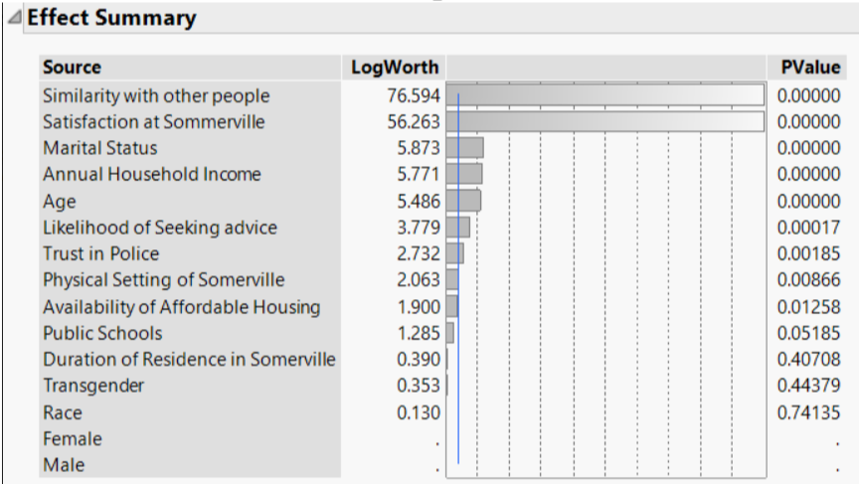
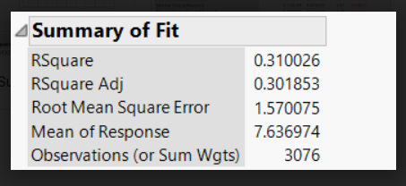
Linear Regression
Continous variable (General Happiness) is the Target
About 8 variables seemed significant
2 predictors stood out as most significant
This served as ‘Feature Selection’ for building more complex models

Slide 17
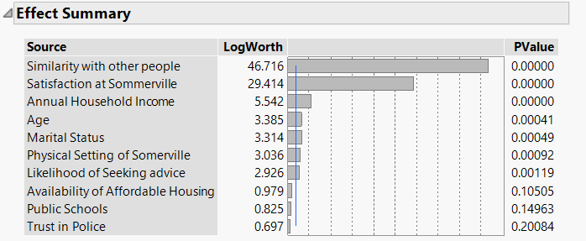
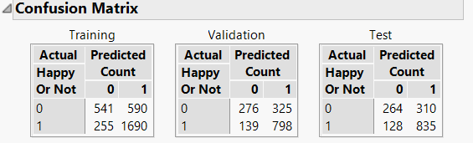
Logistic Regression
Categorical variable (Happy or Not) is the Target
Cutoff – 7.5 on a scale of 10
About 7 variables seemed significant
Accuracy:
Training – 72.5%
Validation – 69.8%
Test – 71.5%

Slide 18
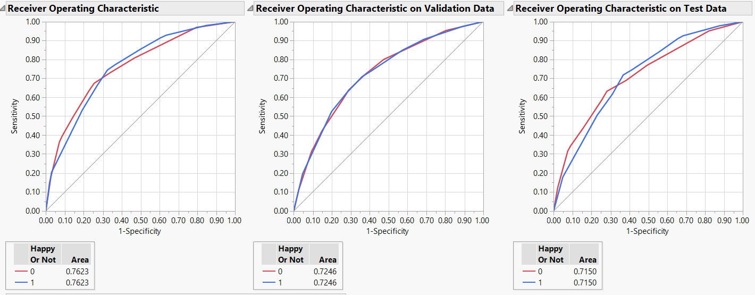
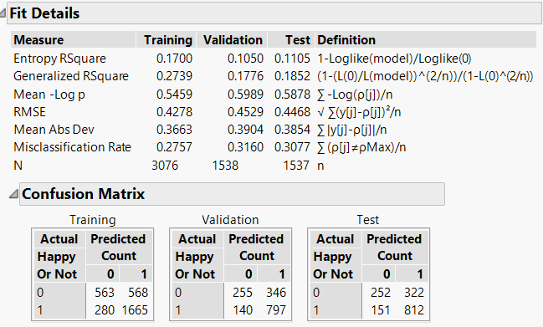
Decision Trees
Partition | Accuracy
Training (50%) | 72.4%
Validation (25%) | 68.4%
Test (25%) | 69.2%

Slide 19
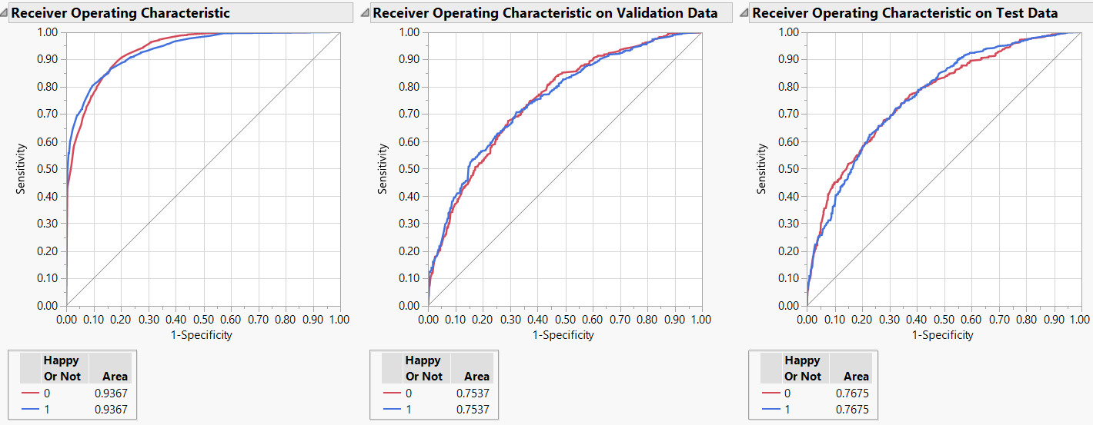
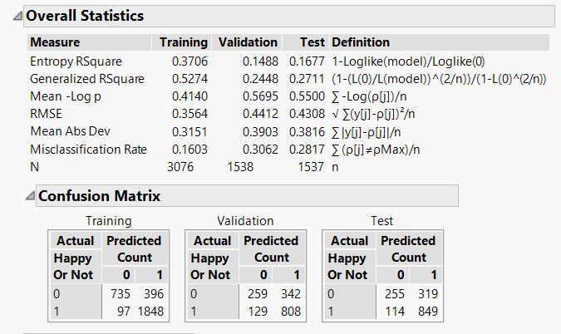
Random Forest / Bootstrap Forest
Partition | Accuracy
Training (50%) | 84%
Validation (25%) | 69.4%
Test (25%) | 71.8%

Slide 20
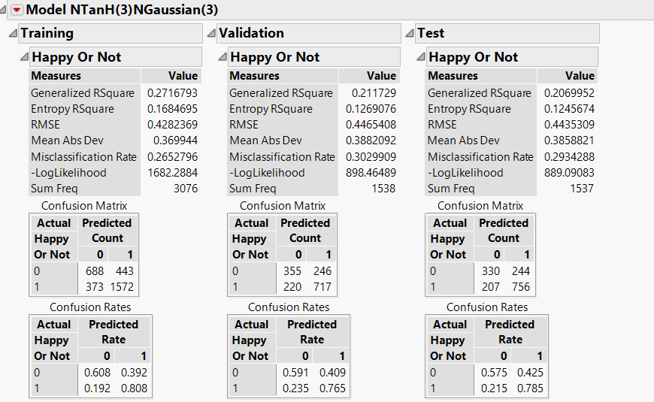
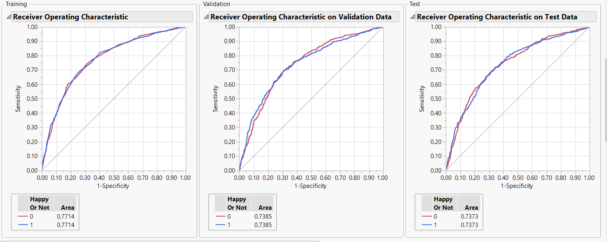
Neural Nets
Maximum Accuracy achieved = 70.6%

Slide 21
Model Comparison
Model Criterion | Neural Nets | Random Forest | Logistic Regression
Total Accuracy On Test Data | 70.6% | 71.8% | 71.5%
Area Under The ROC curve | 0.737 | 0.767 | 0.757
Prediction Of Zero’s | 57% | 44% | 45%

Slide 22
Model Selection: Neural Networks
Ability to learn and model non-linear and complex relationships
No restrictions imposed on input distribution
Can infer relationships from hidden data

Slide 23
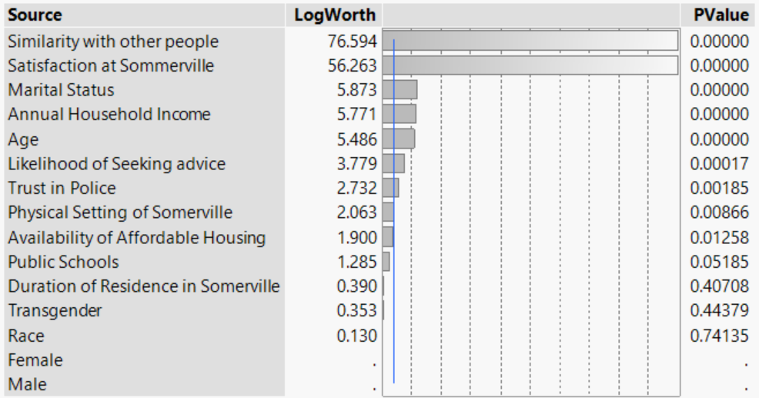
Determinants of Happiness
Significant Determinants:
Satisfaction with Somerville
Similarity with Other People
Insignificant Determinants:
Race
Gender

Slide 24
So, does money buy Happiness?

Slide 25
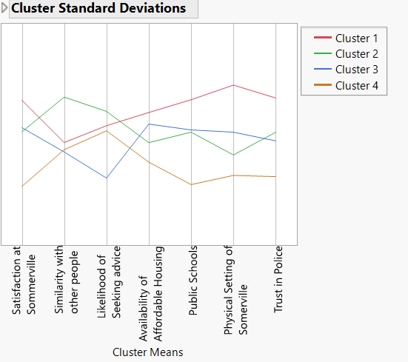
Focus Groups: Targeted Approach
Focus Group 1: Physical Setting
Focus Group 2: Similarity with Other People
Focus Group 3: Affordable Housing
Focus Group 4: Likelihood of Seeking Advice

Slide 26
Any questions ?
Happy to answer

